Slide 1
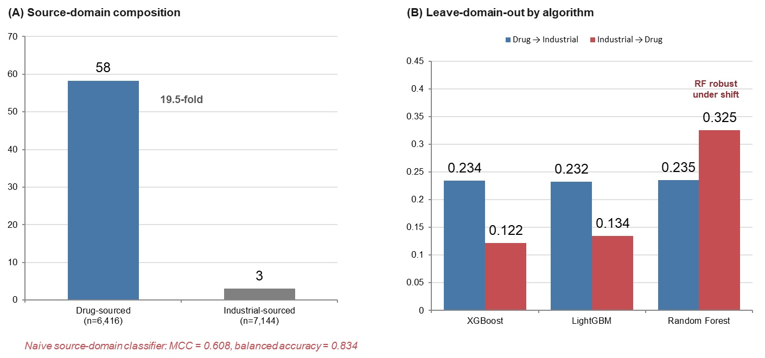
Locked configuration: XGBoost, compact features, raw SMILES

